Slide 1
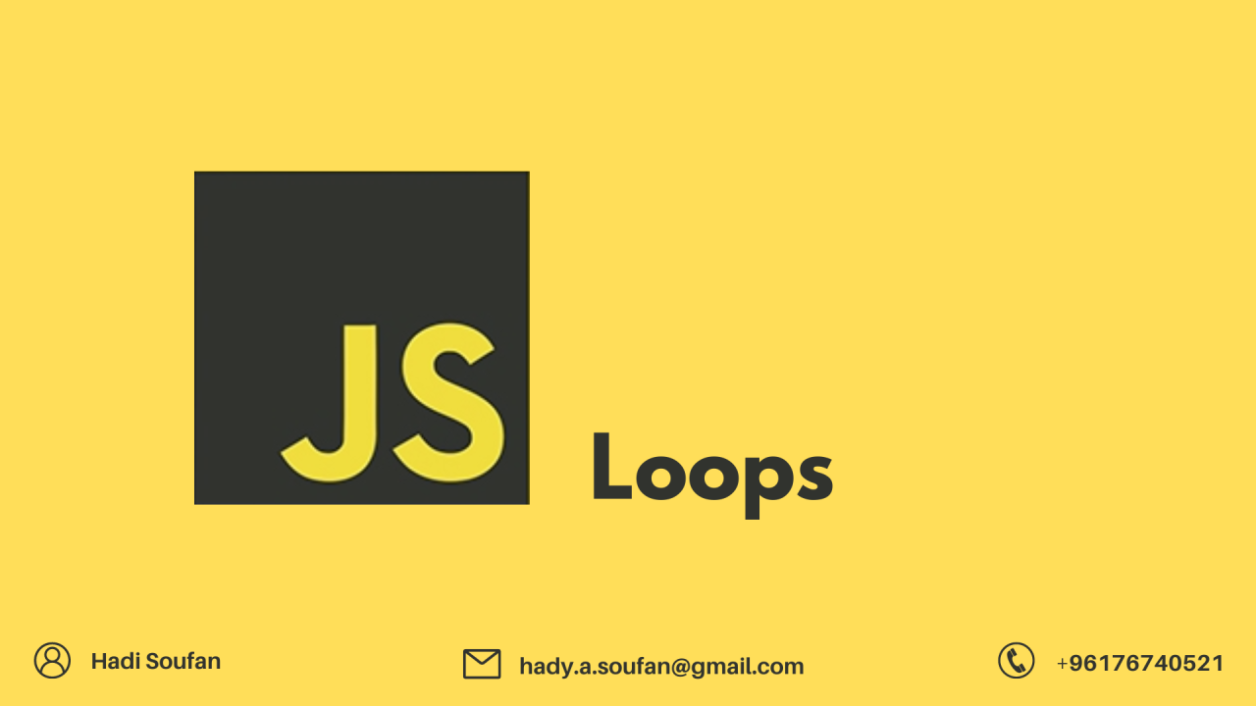

Slide 2
What we Cover Today:
01
02
03
Loop Control
More Practices Previous Lesson
Exercise

Slide 3
Loop Control
Break
The break statement "jumps out" of loops and switches.
When break is encountered in a loop, the loop terminates immediately.
The program control is transfered to the statements following the loop.
No more loop iterations are executed.
Example:
for (let i = 0; i < 10; i++) {
if (i === 3) { break; }
console.log(i);
}
The Output:
0
1
2

Slide 4
Loop Control
Continue
The continue statement skips the current iteration in a loop.
The remaining code in the iteration is skipped and processing moves to the next iteration.
Example:
for (let i = 0; i < 6; i++) {
if (i === 3) {
continue; }
console.log(i);
}
The Output:
0
1
2
4
5

